Slide 1
GCBASIC
PIC18FxxQ35chip Family
Part 17 – Using CLC

Slide 2
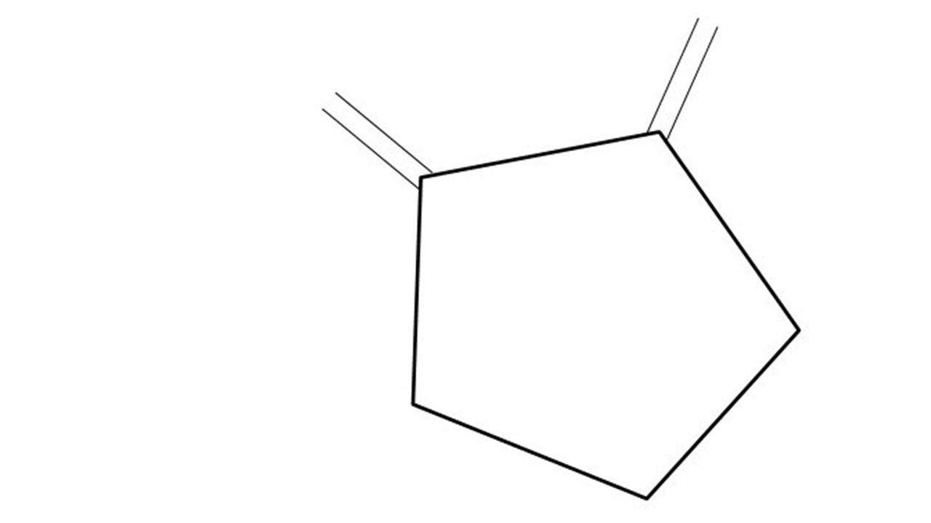
GCBASIC
PIC18FxxQ35chip Family
Part 17 – Using CLC

Slide 3
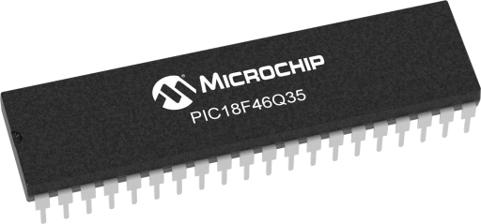
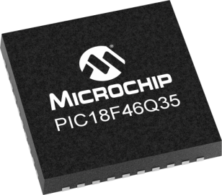
GCBASIC
Like and subscribe!

Slide 4
PIC18FxxQ35
PIC18FxxQ35 is a high performance PIC18
  Digital and analog peripherals for flexible embedded control
  10-bit ADC for accurate analog signal conversion
  Multiple communication interfaces including UART (serial), I²C, and SPI
  PWM modules with CCP and 16-bit resolution for precise timing and motor control
  Configurable Logic Cells (CLCs) for custom hardware-level logic without external components
  Integrated op amps for onboard analog signal conditioning and amplification
The PIC18FxxQ35 offers 28, 40 and 44-pin products in small footprint packages to support customers in a wide variety of applications.

Slide 5
Videos...
Install the hardware and make the board work – make LEDs work
Make four LEDs flash in a sequence
Set the LEDs to represent the value of ADC
Sequence the LEDs with a delay using the value of ADC
Using an input to set the state of the LEDs
Using the reset switch
Using the switch, ADC – make the LEDs flash in a sequence with reverse
Using the serial to display values
Using the timer0 overflow, 8bit timer, 16bit timer to flash the LEDs
Using EEProm – showing values on the serial terminal, and more constants insights
Using I2C with serial to discover I2C devices
Using an I2C GCLD display
Using a SPI GCLD display
Using PWM, many ways, to dim the LEDS
Using Millis and Interrupts
Using storage within the chip – Progmem, SAF memory, EEPROM and DATA blocks
Using CLC
The GCBASIC tool chain
Assembly , alternatives assemblers and MPLAB-X
Summary

Slide 6
GCBASIC Compiler
GCBASIC Compiler
GCBASIC is an Open Source compiler for PIC, AVR and LGT microcontrollers
GCBASIC now supports the 18FxxQ35 chip family
GCBASIC now supports 1400+ microcontrollers

Slide 7
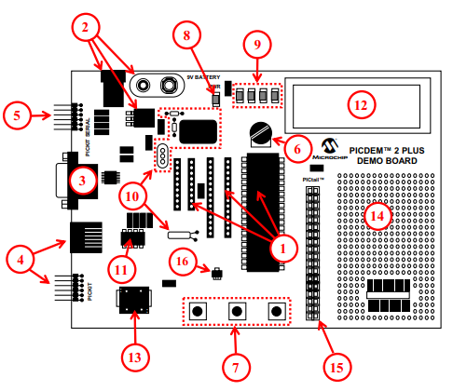
PICDEM 2 Plus Demonstration
Board
1. 18-, 28- and 40-pin DIP sockets
(although three sockets are provided, only one device may be used at a time)
2. On-board, +5V regulator for direct input from 9V, 100 mA AC/DC wall adapter or 9V battery, or hooks for a +5V, 100 mA regulated DC supply
3. RS-232 socket and associated hardware for direct connection to an RS-232 interface
4. Programmer/debugger connectivity supporting MPLAB® ICD 3, MPLAB REAL ICE and PICkitPlus
5. PICkit Serial Connector for analysis of serial communications peripherals such as SPI or I2C™
6. 5 k pot for devices with analog inputs
7. Three push button switches for external stimulus and Reset
8. Power-on indicator LED
9. Four LEDs connected to PORTB
10. On-board external oscillators including:
a) Unpopulated DIP socket for canned crystal oscillator (Y2)
b) RC oscillator circuit (R4, C3)
c) Unpopulated holes for crystal connection (Y1)
d) 32.768 kHz crystal for Timer1 clock operation (Y3)
11. 32K x 8 Serial EEPROM
12. LCD display
13. Piezo buzzer
14. Prototype area for user hardware
15. Expansion Header for PICtail™ daughter card connectivity or user access to MCU pins
16. Microchip TC74 thermal sensor
Plus SPI GLCD
3A

Slide 8
CLC
CLC Functionality
  The CLC module allows users to implement custom logic functions directly in hardware, providing flexibility without CPU intervention
Purpose
  It can be used to create complex logic functions with simple configurations

Slide 9
CLC
Key Features
  Logic Gates: Configures standard logic gates like AND, OR, XOR, etc
  Sequential Logic: Supports latches and flip-flops
  Input Sources: Can use internal signals (from other peripherals) and external signals (from pins)
  Output Options: Outputs can be routed to other peripherals or I/O pins
Applications
  Custom PWM Generation: Used for tasks like motor control
  Data Signal Modulation: Can be used to create custom communication protocols
  LED Control: Efficiently manage LED lighting sequences.

Slide 10
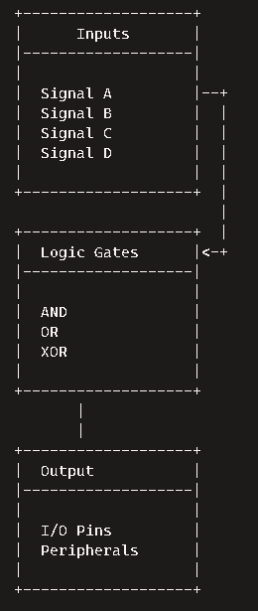
CLC
CLC Diagram
  Inputs
    Up to 16 input sources can be selected from internal and external signals
  Logic Gates Configuration
    Configurable logic gates like AND, OR, XOR are used to combine the inputs
  Sequential Logic Options
    Supports sequential elements like latches and flip-flops
  Output
    The final logic output can be routed to I/O pins or other peripherals

Slide 11
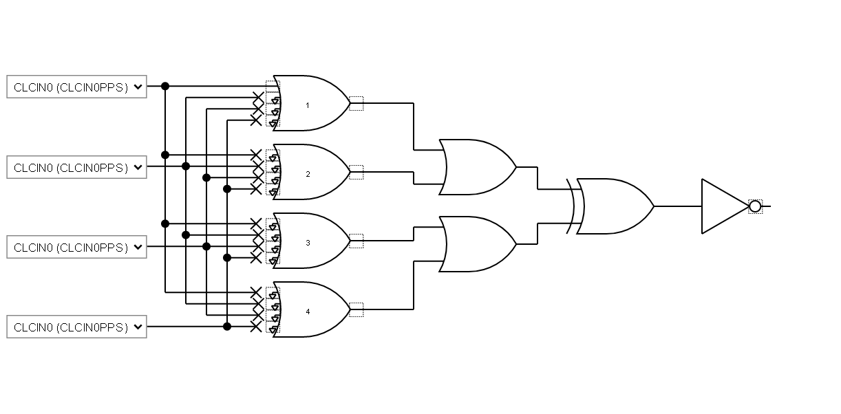
CLC
Digital logic circuit diagram consisting of multiple logic gates. A detailed breakdown:
Inputs:
  CLCIN0 (CLCIN0PPS): The primary input signal fed into the circuit.
Logic Gates:
  AND Gates: There are several AND gates that process the input signals. These gates output a high signal (1) only if all their inputs are high.
  OR Gates: The outputs from the AND gates are fed into OR gates. These gates output a high signal if at least one of their inputs is high.
  NOT Gate: The final output from the OR gates is sent through a NOT gate, which inverts the signal. If the input is high, the output will be low, and vice versa.
Outputs:
  The result of the NOT gate is the final output of the circuit.

Slide 12
Lab
Create an example using
  Microchip Standalone MCC
    https://www.microchip.com/en-us/tools-resources/configure/mplab-code-configurator#download
    C:\Users\{userID}\.mcc
      C:\Users\{userID}\.mcc\mcc_generated_files\clc\src\clc1.c - for CLC
      C:\Users\{userID}\.mcc\mcc_generated_files\system\src\pins.c - for PPS
  GCCode
    Basic Hardware
    Merge contents
  Test and enjoy

Slide 14
Videos...
Install the hardware and make the board work – three LED programs
Make four LEDs flash in a sequence
Set the LEDs to represent the value of ADC
Sequence the LEDs with a delay using the value of ADC
Using an input to set the state of the LEDs
Using the reset switch
Using the switch, ADC – make the LEDs flash in a sequence with reverse
Using the serial to display values
Using the timer0 overflow, 8bit timer, 16bit timer to flash the LEDs
Using EEProm – showing values on the serial terminal, and more constants insights
Using I2C with serial to discover I2C devices
Using I2C GCLD display solutions
Using a SPI GLCD display solutions
Using PWM, 6 ways, to dim the LEDS
Using an external interrupt to control an LED
Using storage within the chip
Using CLC
The GCBASIC tool chain
Assembly , alternatives assemblers and MPLAB-X
Summary

Slide 15
GCBASIC
PIC18FxxQ35
Part 17 - Using CLC

